Slide 1

Callink - an Urdu-first AI order taking System
CS455: Natural Language Processing Project
Shehryar Nadir 2022545
Adina Kamran 2022044
1

Slide 2

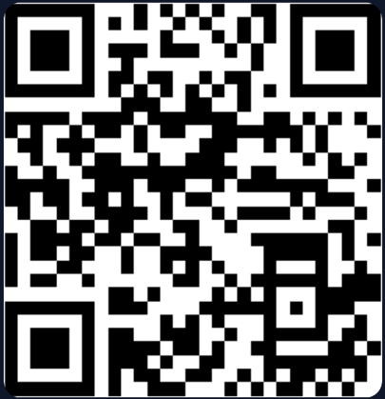

Project Overview
The Concept
Problem Solved
An AI-powered automated call handling system specifically optimized for the Pakistani market and Urdu language nuances.
Eliminates high operational costs, inconsistent service quality, and human errors prevalent in manual telephone order-taking.
NLP Innovation
Target Market
Moving beyond rigid IVR menus to flexible, LLM-driven dialogue management for high-frequency environments.
Empowering Small and Medium Enterprises (SMEs) to scale their operations without significantly increasing workforce requirements.
scan QR code for website access
2

Slide 3





NLP & AI Core Components
STT Processing
NLU Engine
TTS Synthesis
Deepgram Streaming for low-latency conversion of 8kHz mono audio to text stream.
Gemini 2.5 Flash understanding Urdu-English code-mixed intent and context.
Deepgram human-like voice synthesis providing real-time audio feedback to users.
"The system is engineered to handle Urdu/English code-mixing effortlessly, allowing natural localized conversation."
3

Slide 4
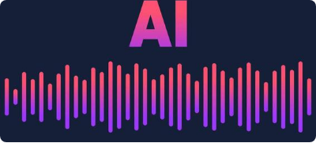
System Workflow
Inbound Call
Transcription
Processing
Execution
Response
Twilio Voice Stream (8kHz)
STT Processing (Deepgram)
NLP & Intent Extraction (Gemini)
DB Interaction & Order Log
TTS Output Generation
4

Slide 5

Implementation Strategy
Real-time Pipeline: Built with FastAPI (Python) using asynchronous WebSockets to maintain low-latency sub-second response times.
Dialogue Logic: Context-aware state management ensuring order details (items, quantity, address) are captured accurately.
Performance Metrics
Target Latency: < 1.2s
Speech Accuracy: 94%+
Barge-in Support: Specialized logic allowing the AI to detect user interruption and pause speech synthesis instantly.
Uptime: 99.9% (via Cloud Hosting)
Cloud Deployment: Hosted on Railway for scalable, active cloud availability.
5

Slide 6
Technologies Used
Category | Technology Used | Role in System
AI & LLM | Gemini 2.5 Flash | Core NLU, Entity Extraction & Reasoning
Voice Services | Deepgram Nova-2 | Streaming STT & Expressive TTS
Communication | Twilio API | SIP/PSTN Phone Number Integration
Backend | FastAPI / Python | Async WebSocket Management & API Logic
Database | SQLite / SQLAlchemy | Structured Order Logging & Call Records
Deployment | Railway Cloud | Global Infrastructure Hosting
6

Slide 7
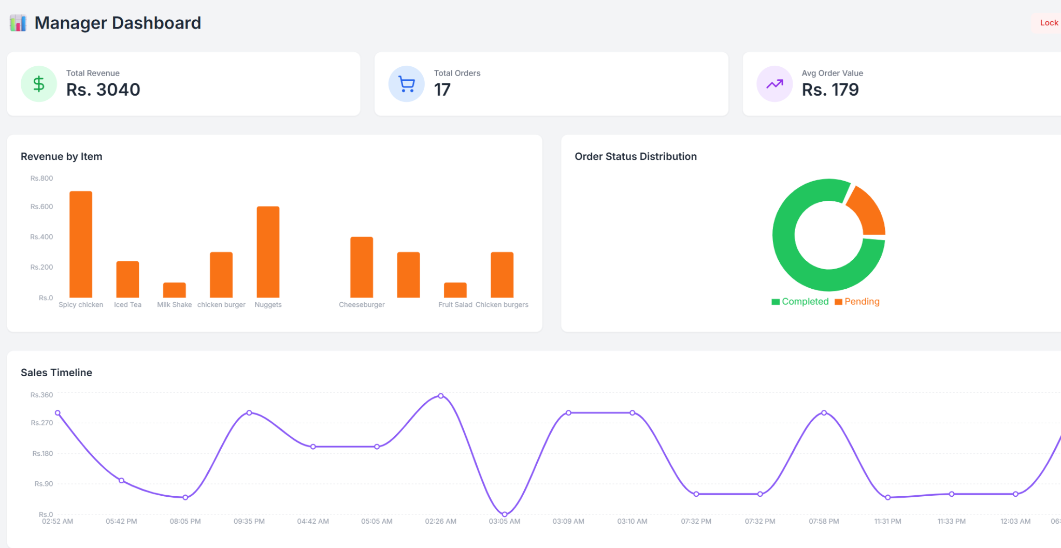

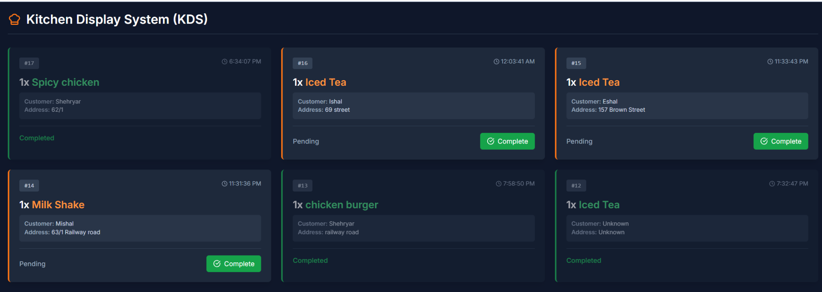

Management & Portals
AI Calling Interface
Real-time interaction log and menu display for monitoring active calls.
Kitchen Display System (KDS)
Live order portal for kitchen staff to manage automatically extracted voice orders.
Manager Dashboard
Analytical view for business owners tracking revenue, call success, and trends.
7

Slide 8

Thank You!
Callink - an Urdu-first AI order taking System
8

